Slide 1


Slide 3
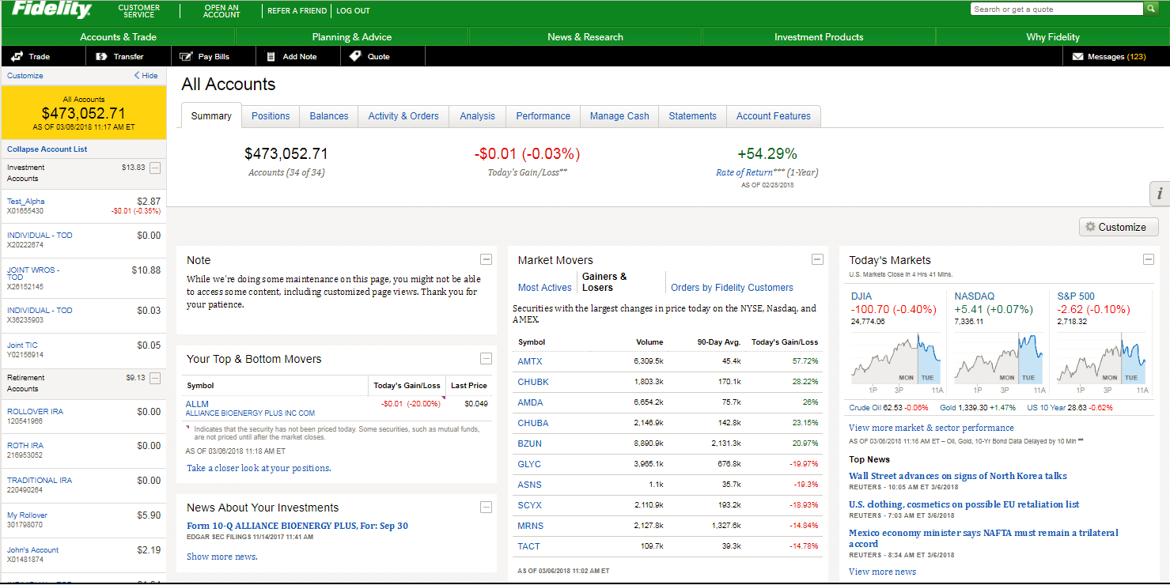

Safe mode
Assures the customer experience under the high volume traffic, we can enable the All Accounts view to show a reduced number of Summary Cards.

Slide 4
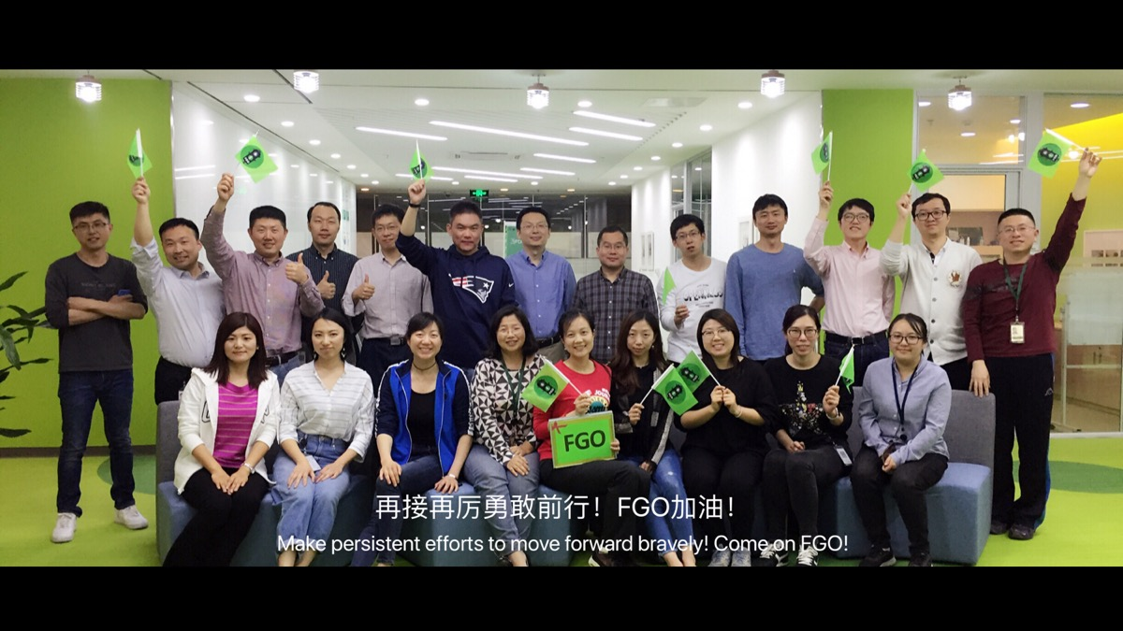

Fidelity GO
50K+ accounts have been created.
It allows our customers to go from saving to investing in 5 minutes.

Slide 5
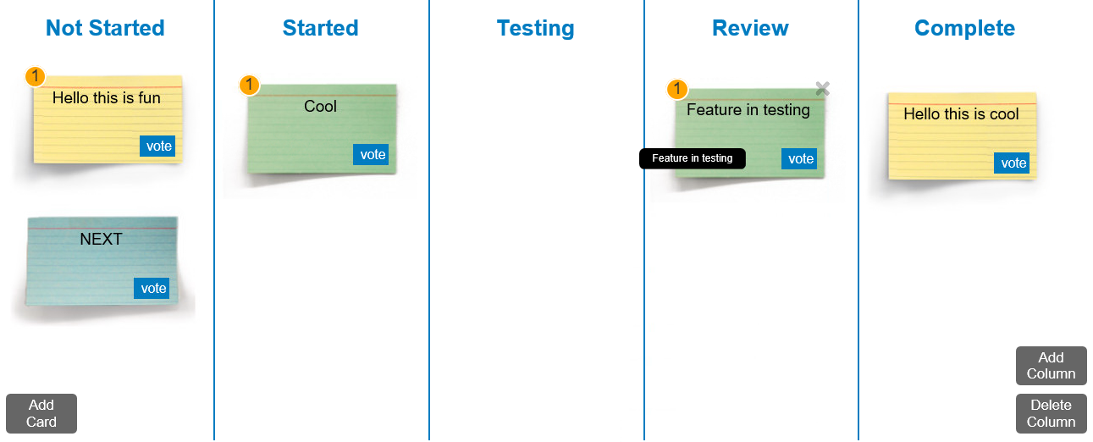

Pangu
Idea Board
Pangu Idea board like light Mural – it helps facilitating discussion efficiently with participants from multiple locations.

Slide 6
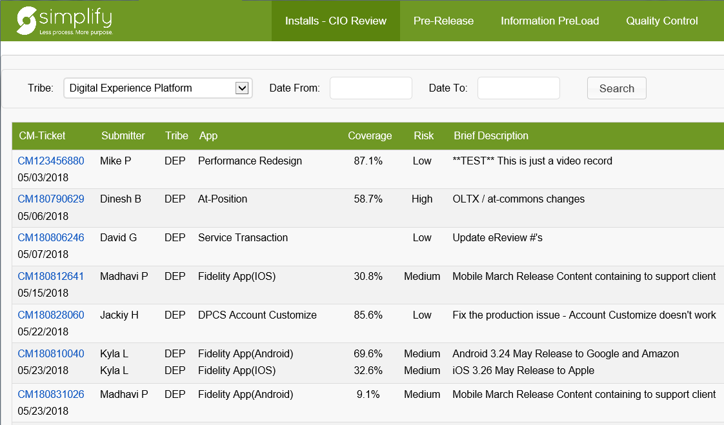
Simplify
Simplify makes our employee happy because it reduces complexity and saves time when preparing for the install.

Slide 7
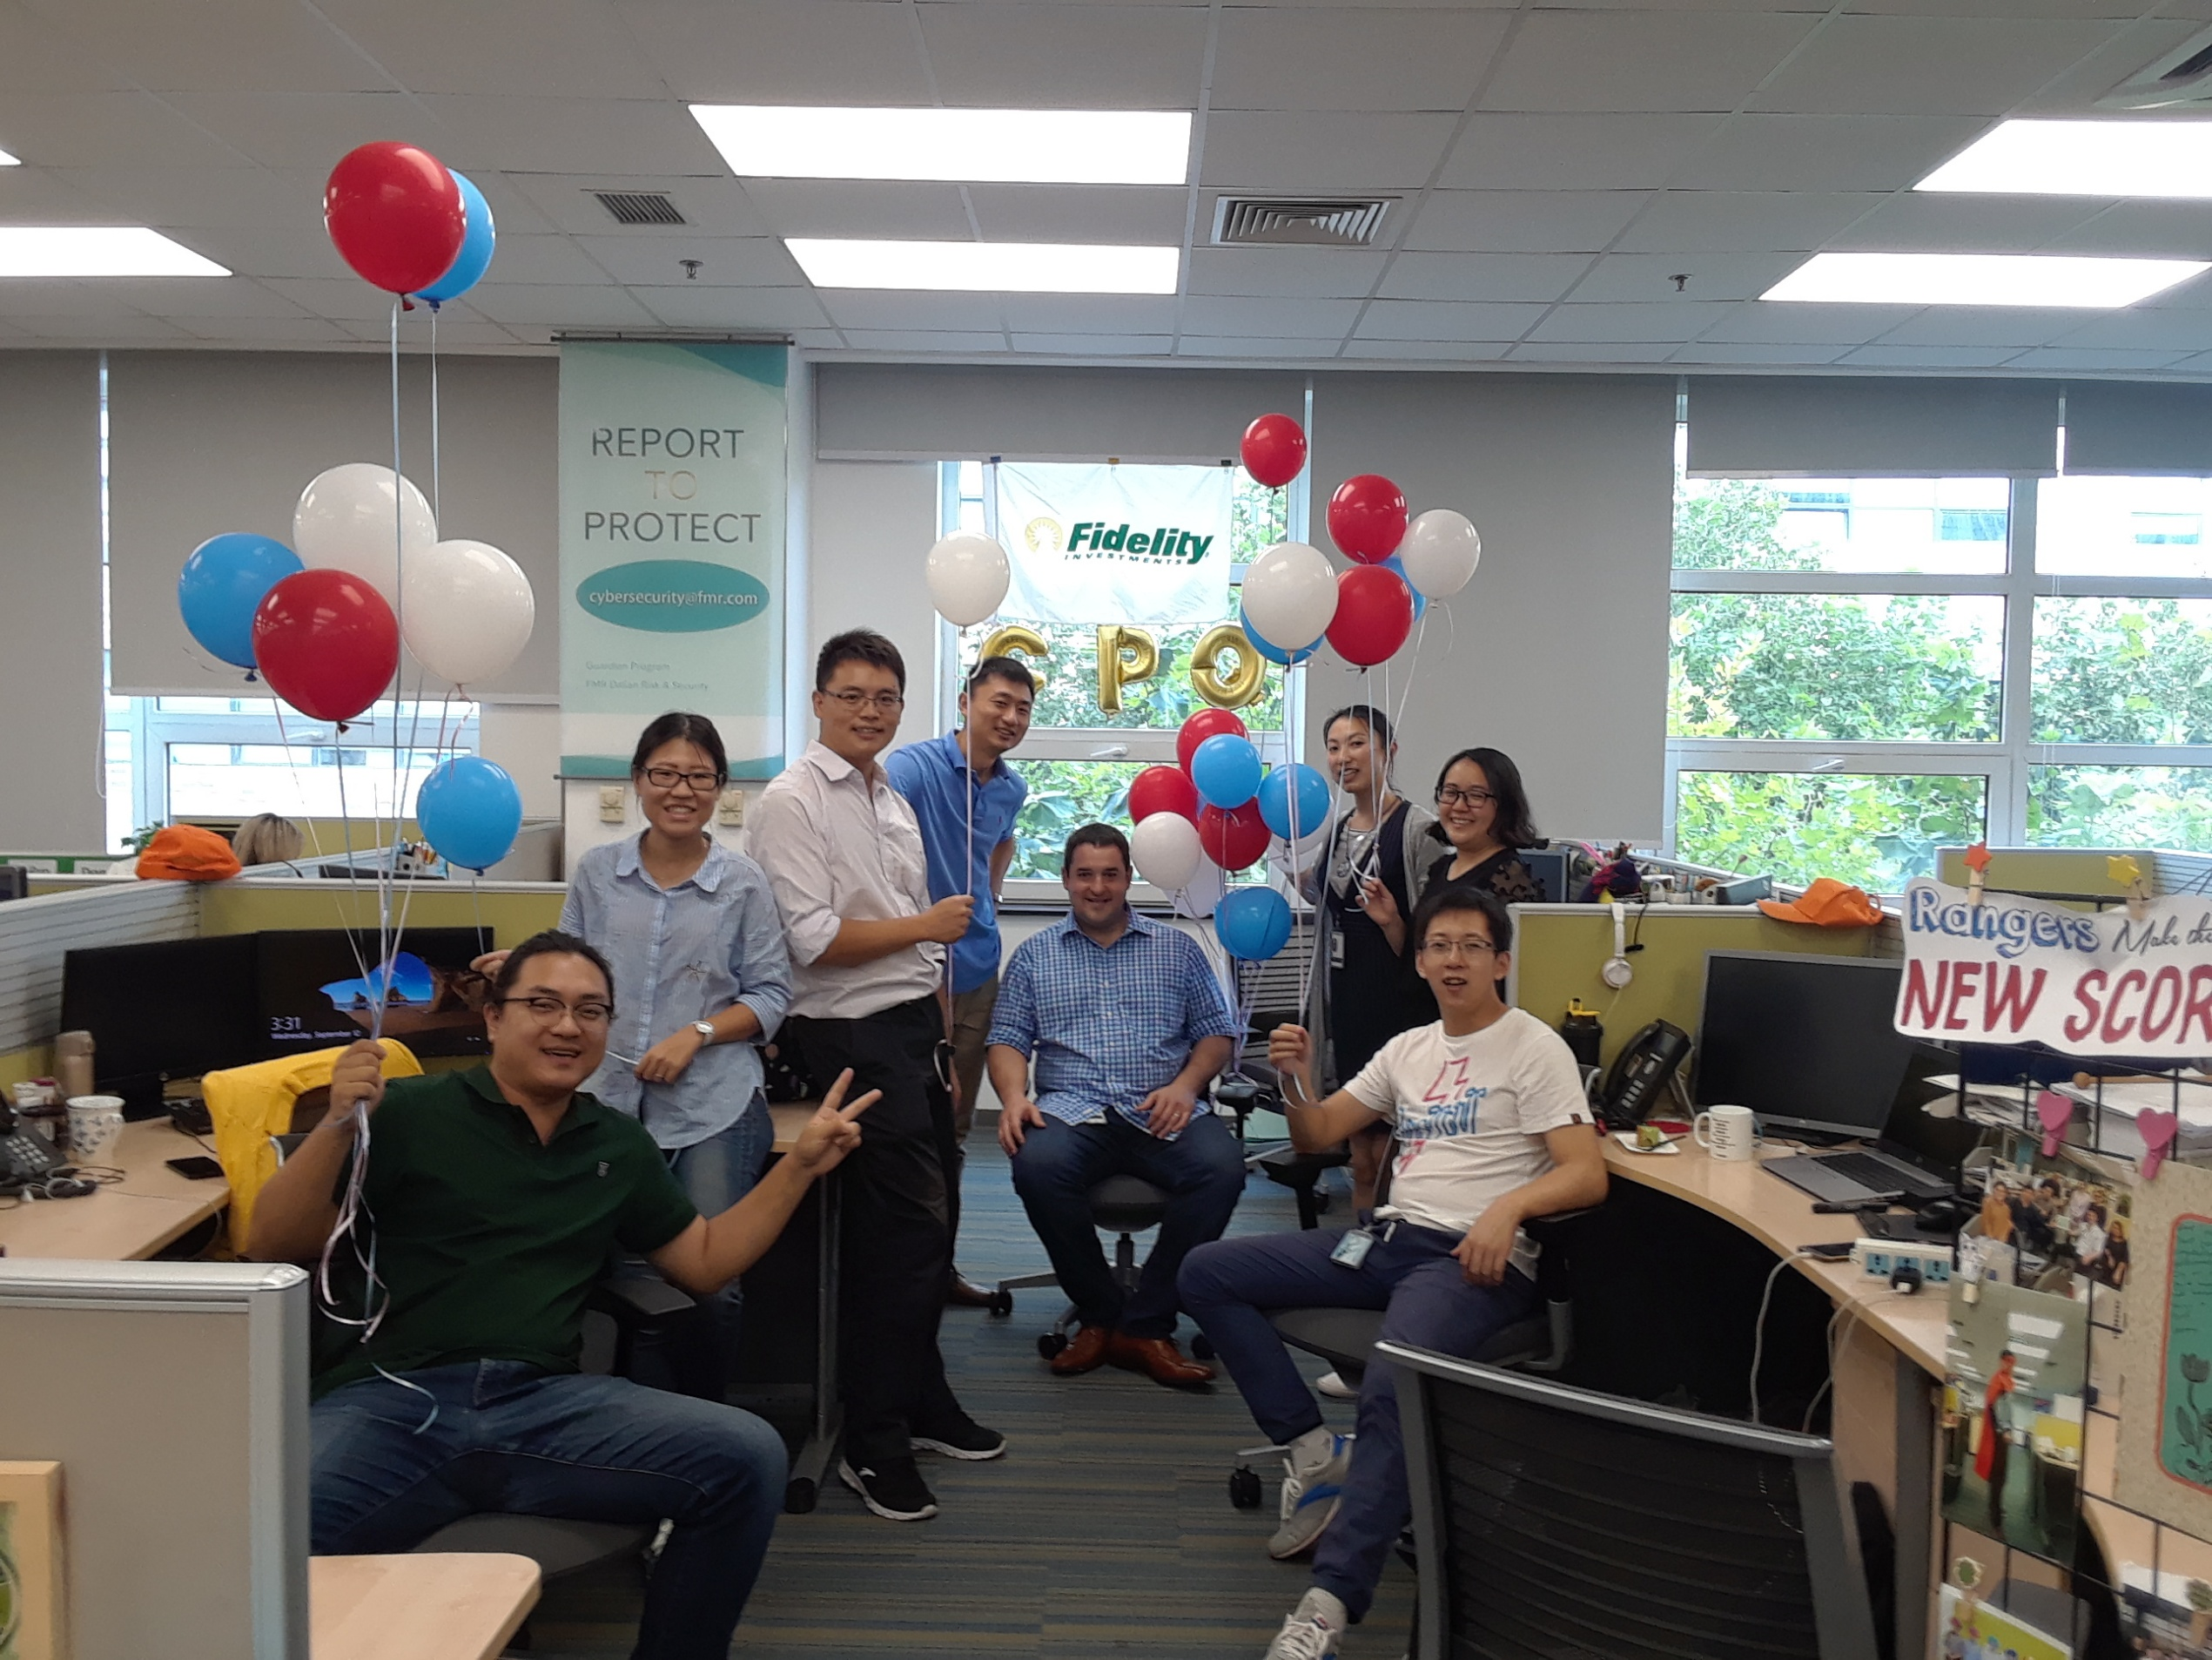

GPQ
GPQ score engine as launched on Jun 6th 2018
GPQ supports PWM customers to do financial scoring based on household multiple goals.

Slide 8
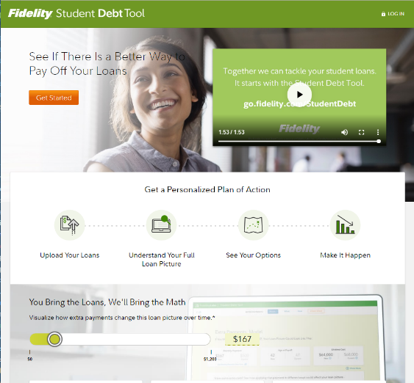
Student Debt
Successfully transitioned the Student Debt Tool from Fidelity Lab
and completed a Google sprint to Kick-start development.

Slide 9
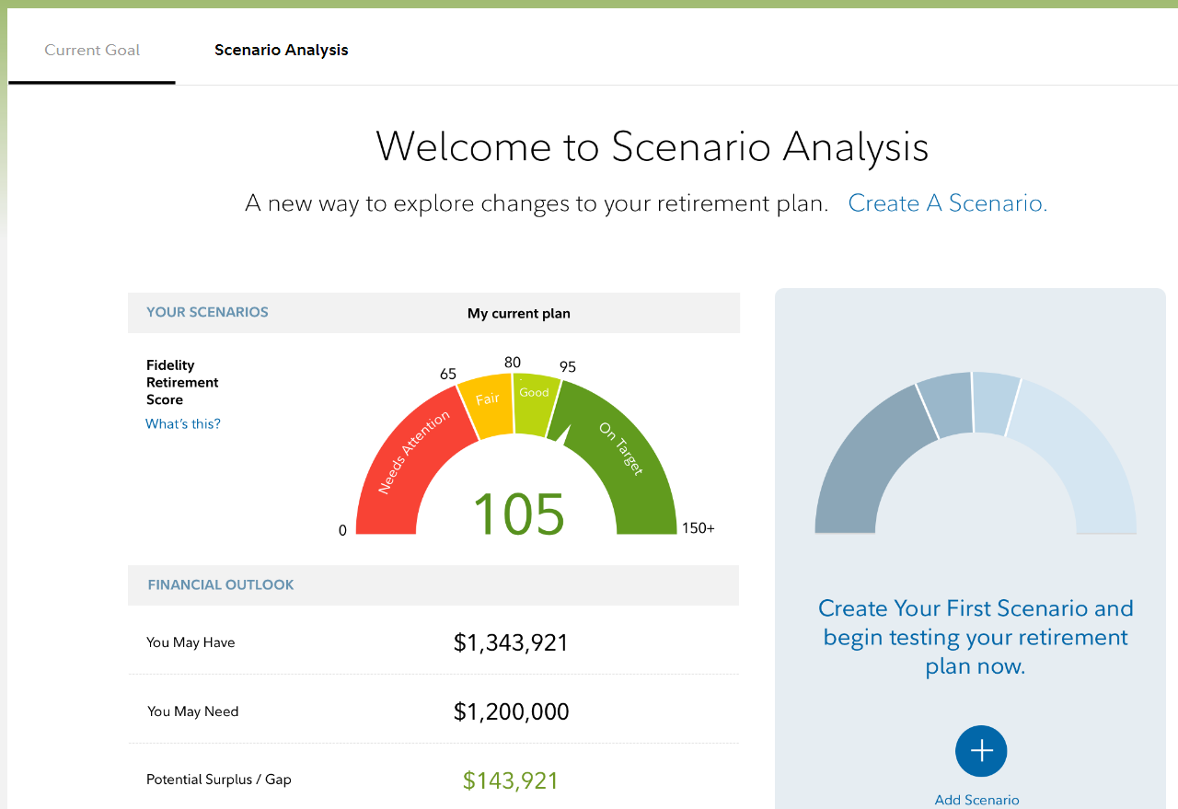

Scenario Analysis
Over 100K scenarios have been created after PGC enhancements were launched of Scenario Analysis with Athena engine in July 2018.

Slide 10
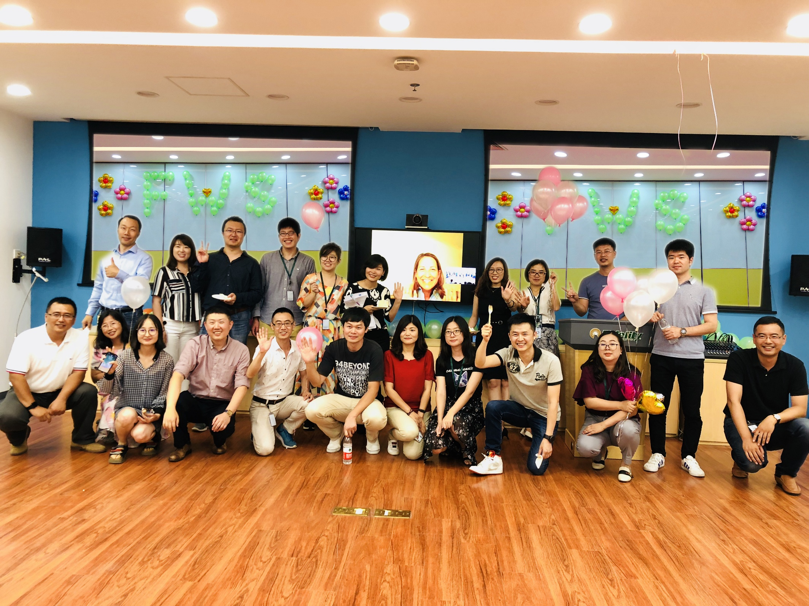
FWS
Over 800K customers enrolled in FWS to benefit from new financial advisory fee charge changes.

Slide 11
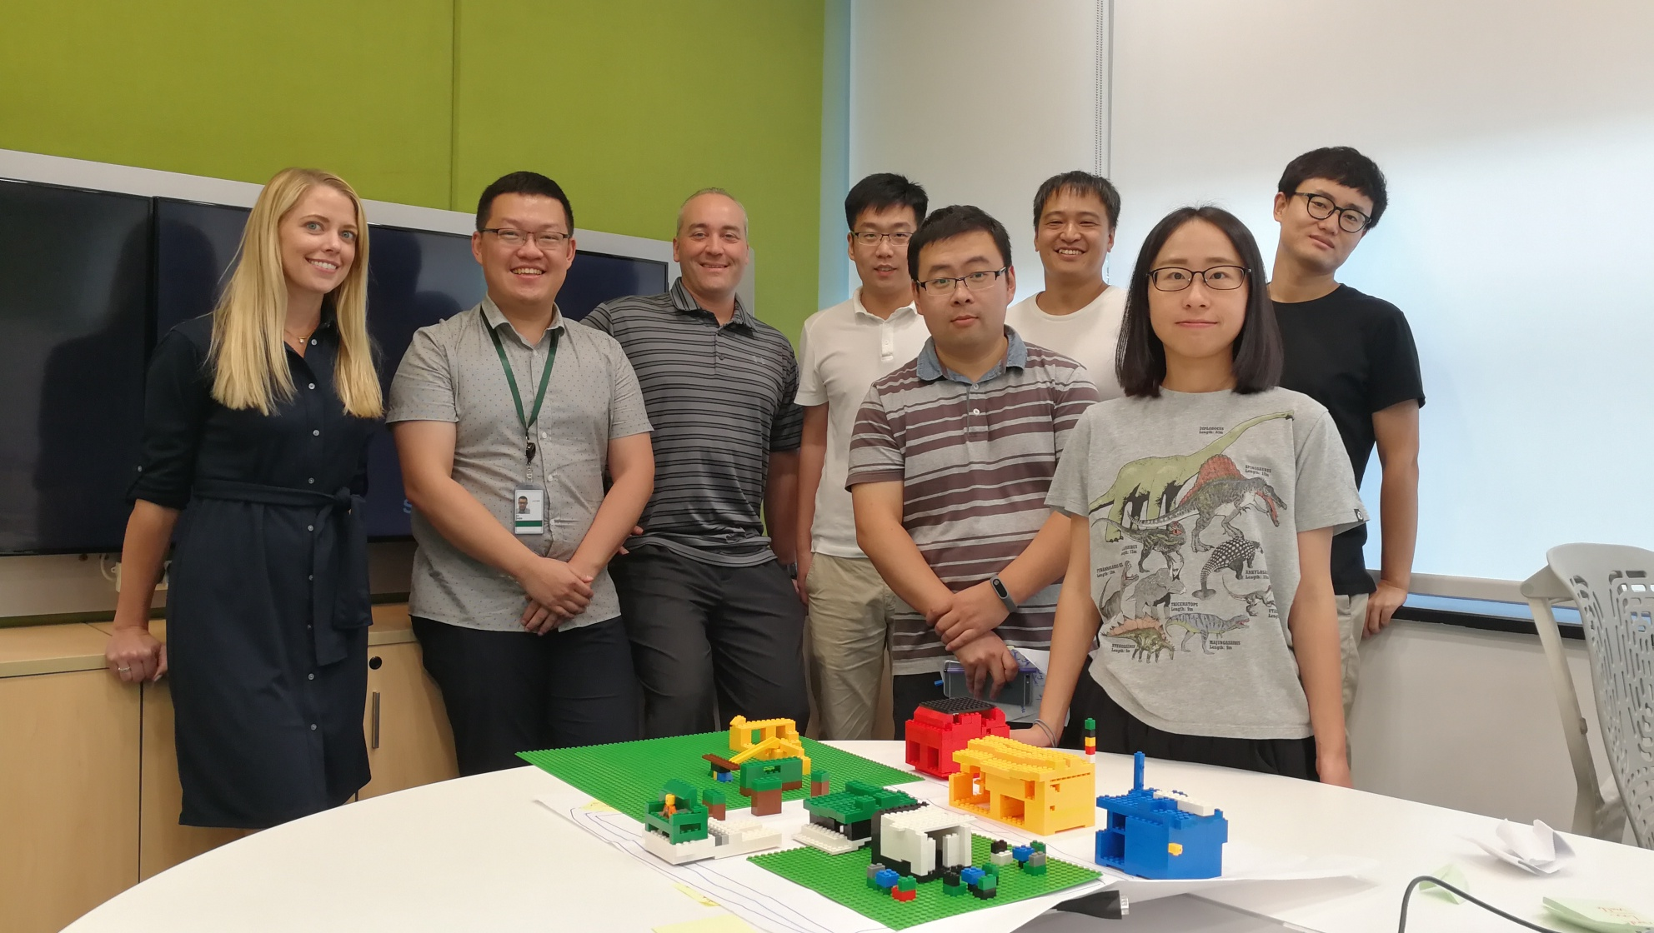

Corporate Action
Helped 56K customers to be aware of events relevant to them.
It allows customers an entry point to fundamental education and access specific event terms prior to providing instructions to participate.

Slide 12
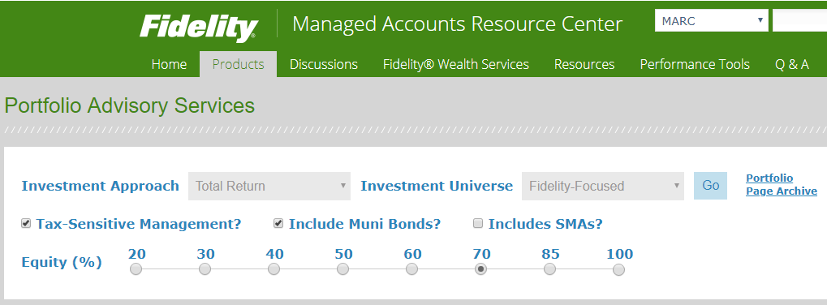
UMA
Released in August 2018.
UMA is a single common investment solution for all discretionarily-managed, multi-asset class portfolios.

Slide 13
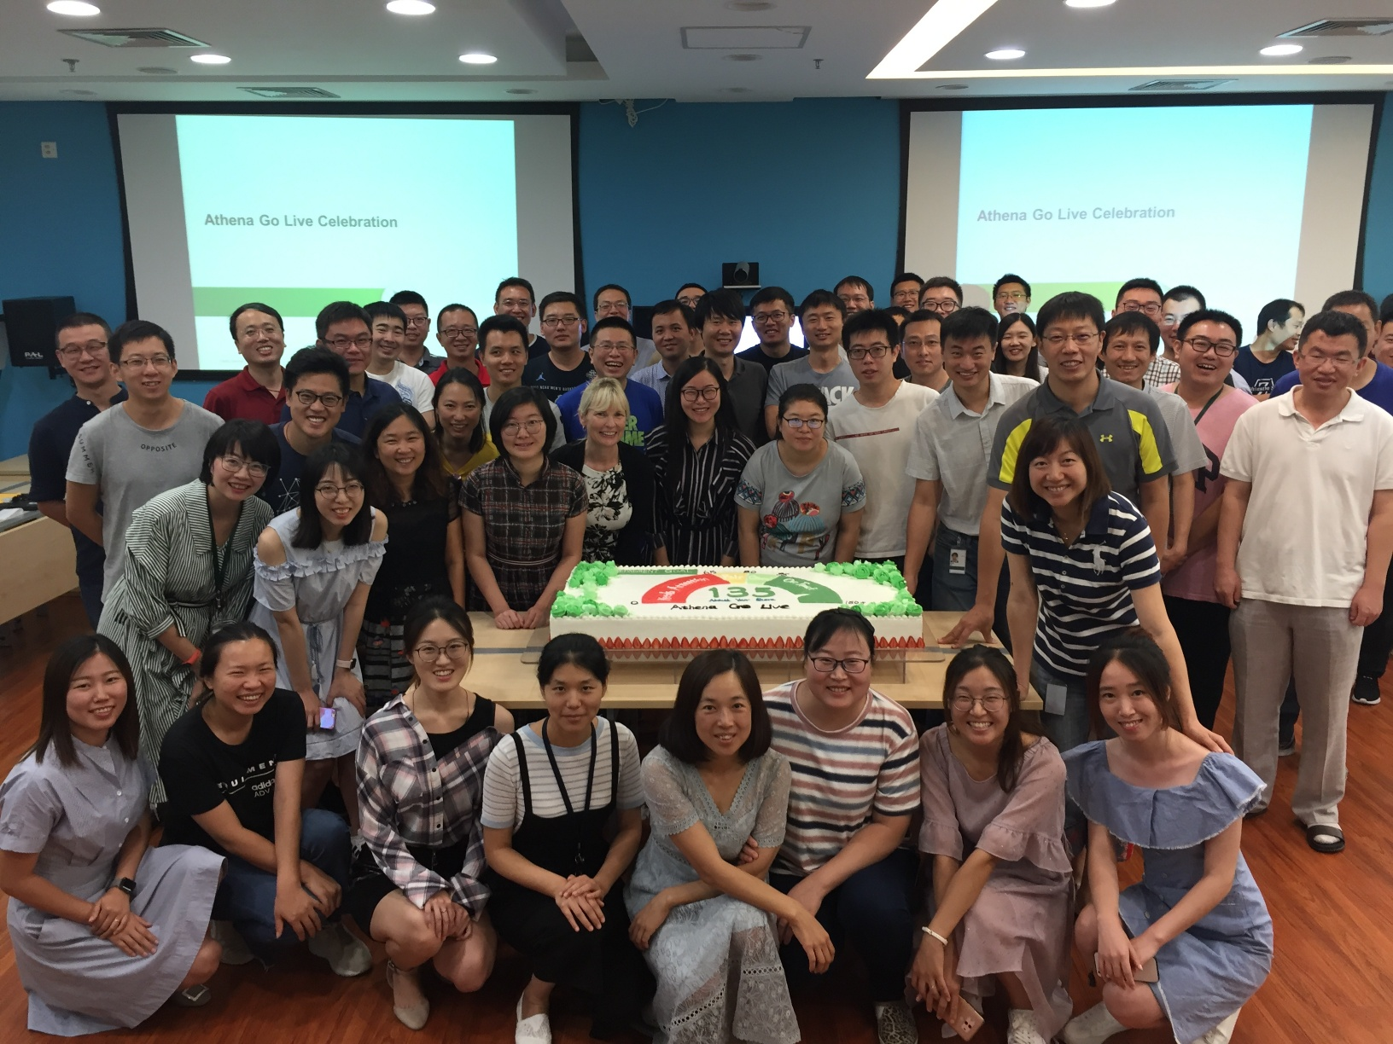
Athena
Go Live
Athena went live in August 2018.
It enables customer to optimize their retirement plans with a new friendly user interface.

Slide 14
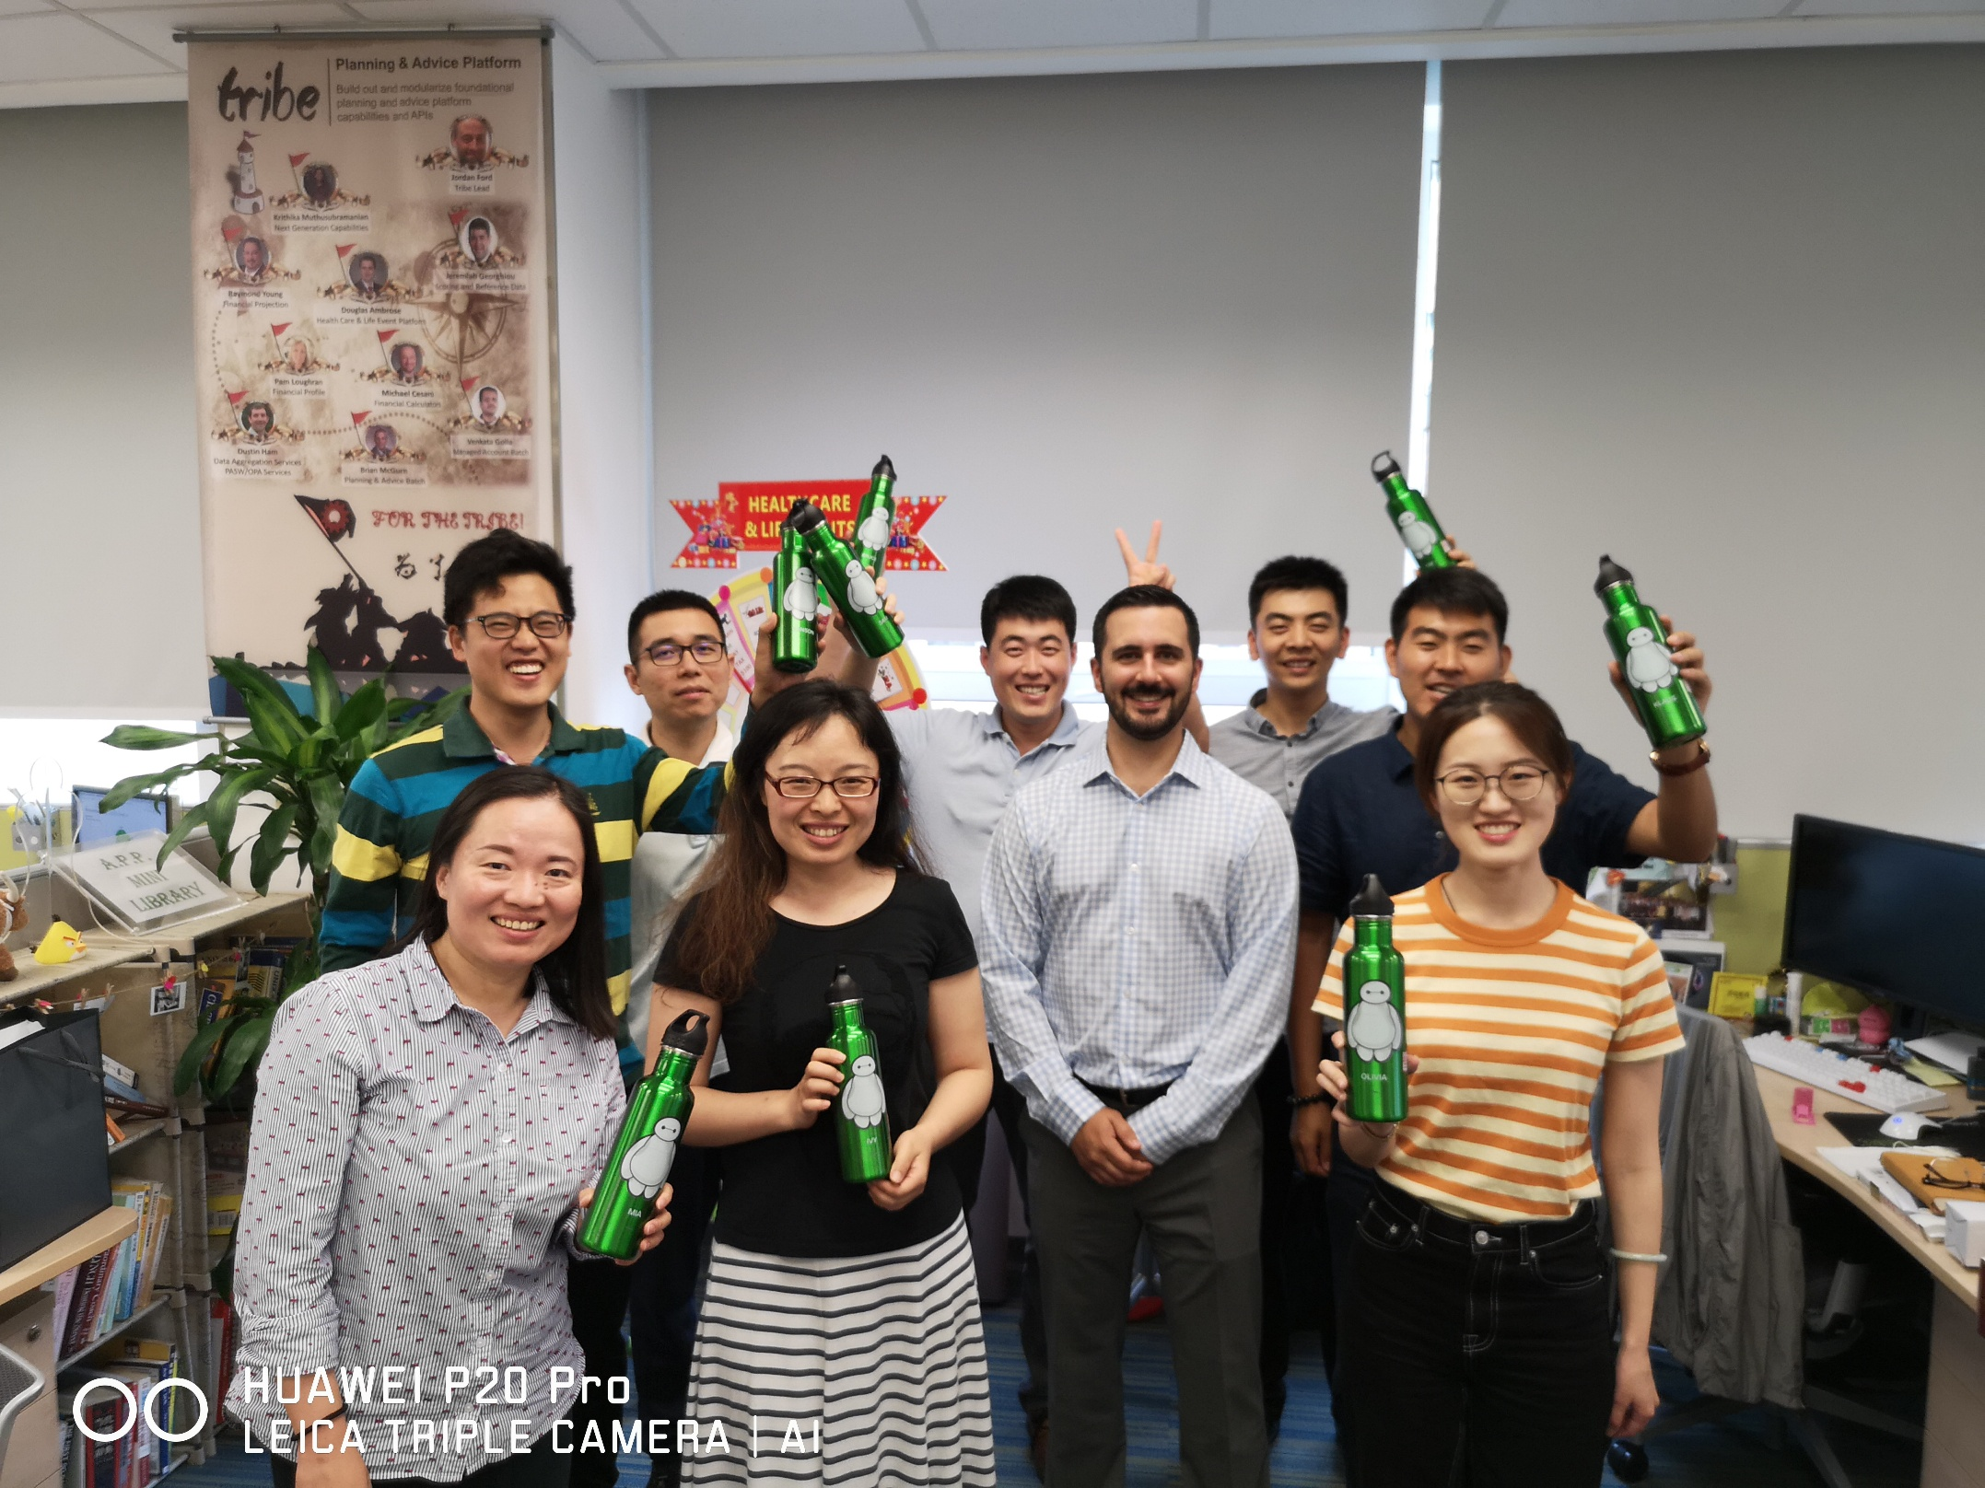
Savings
Prioritizer
Released in September 2018.
It is an important start to a journey that eventually extends to planning experiences accessed by million of people a year.

Slide 15
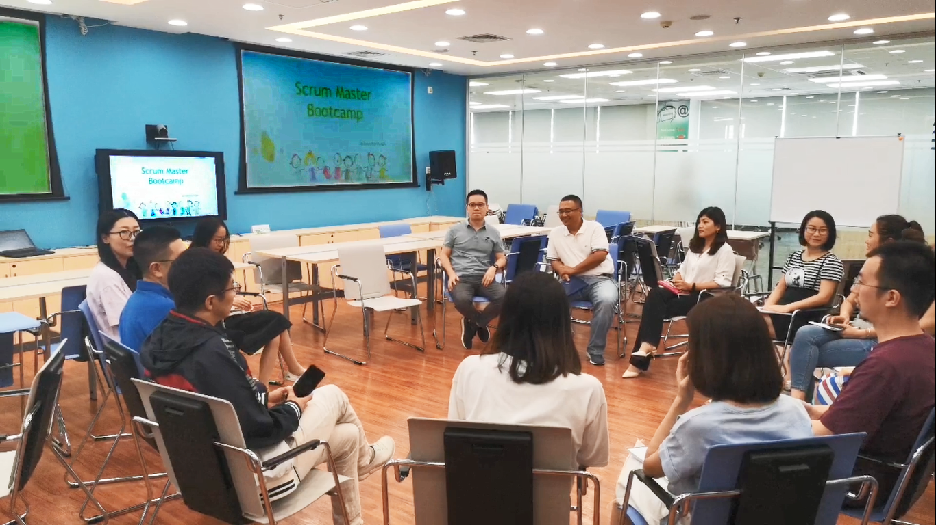
Scrum Master Boot Camp
10 associates graduated from the first Scrum Master Boot Camp in early September 2018.
It helps to foster the associate who are either new or potential scrum master.

Slide 16
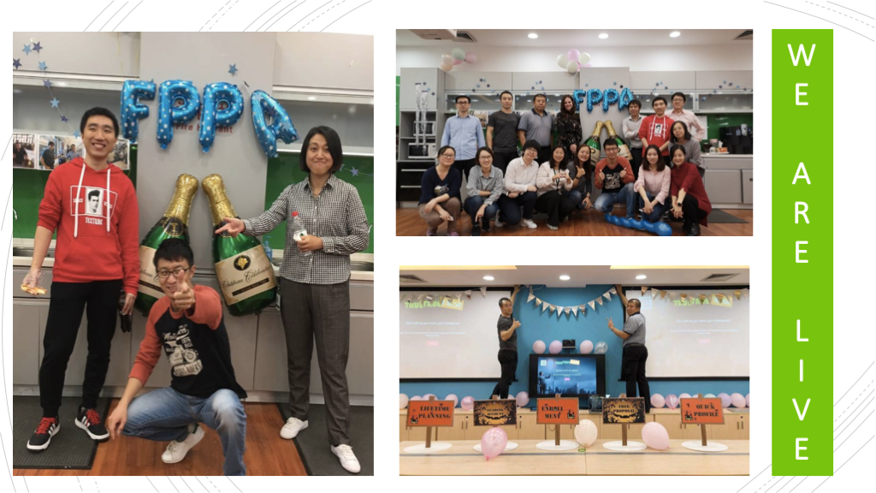

FPPA
Went live in October 2018.
FPPA provides our customer with the simplicity and power of Robot with the personalization and relationship aspects of traditional wealth management offerings.

Slide 17
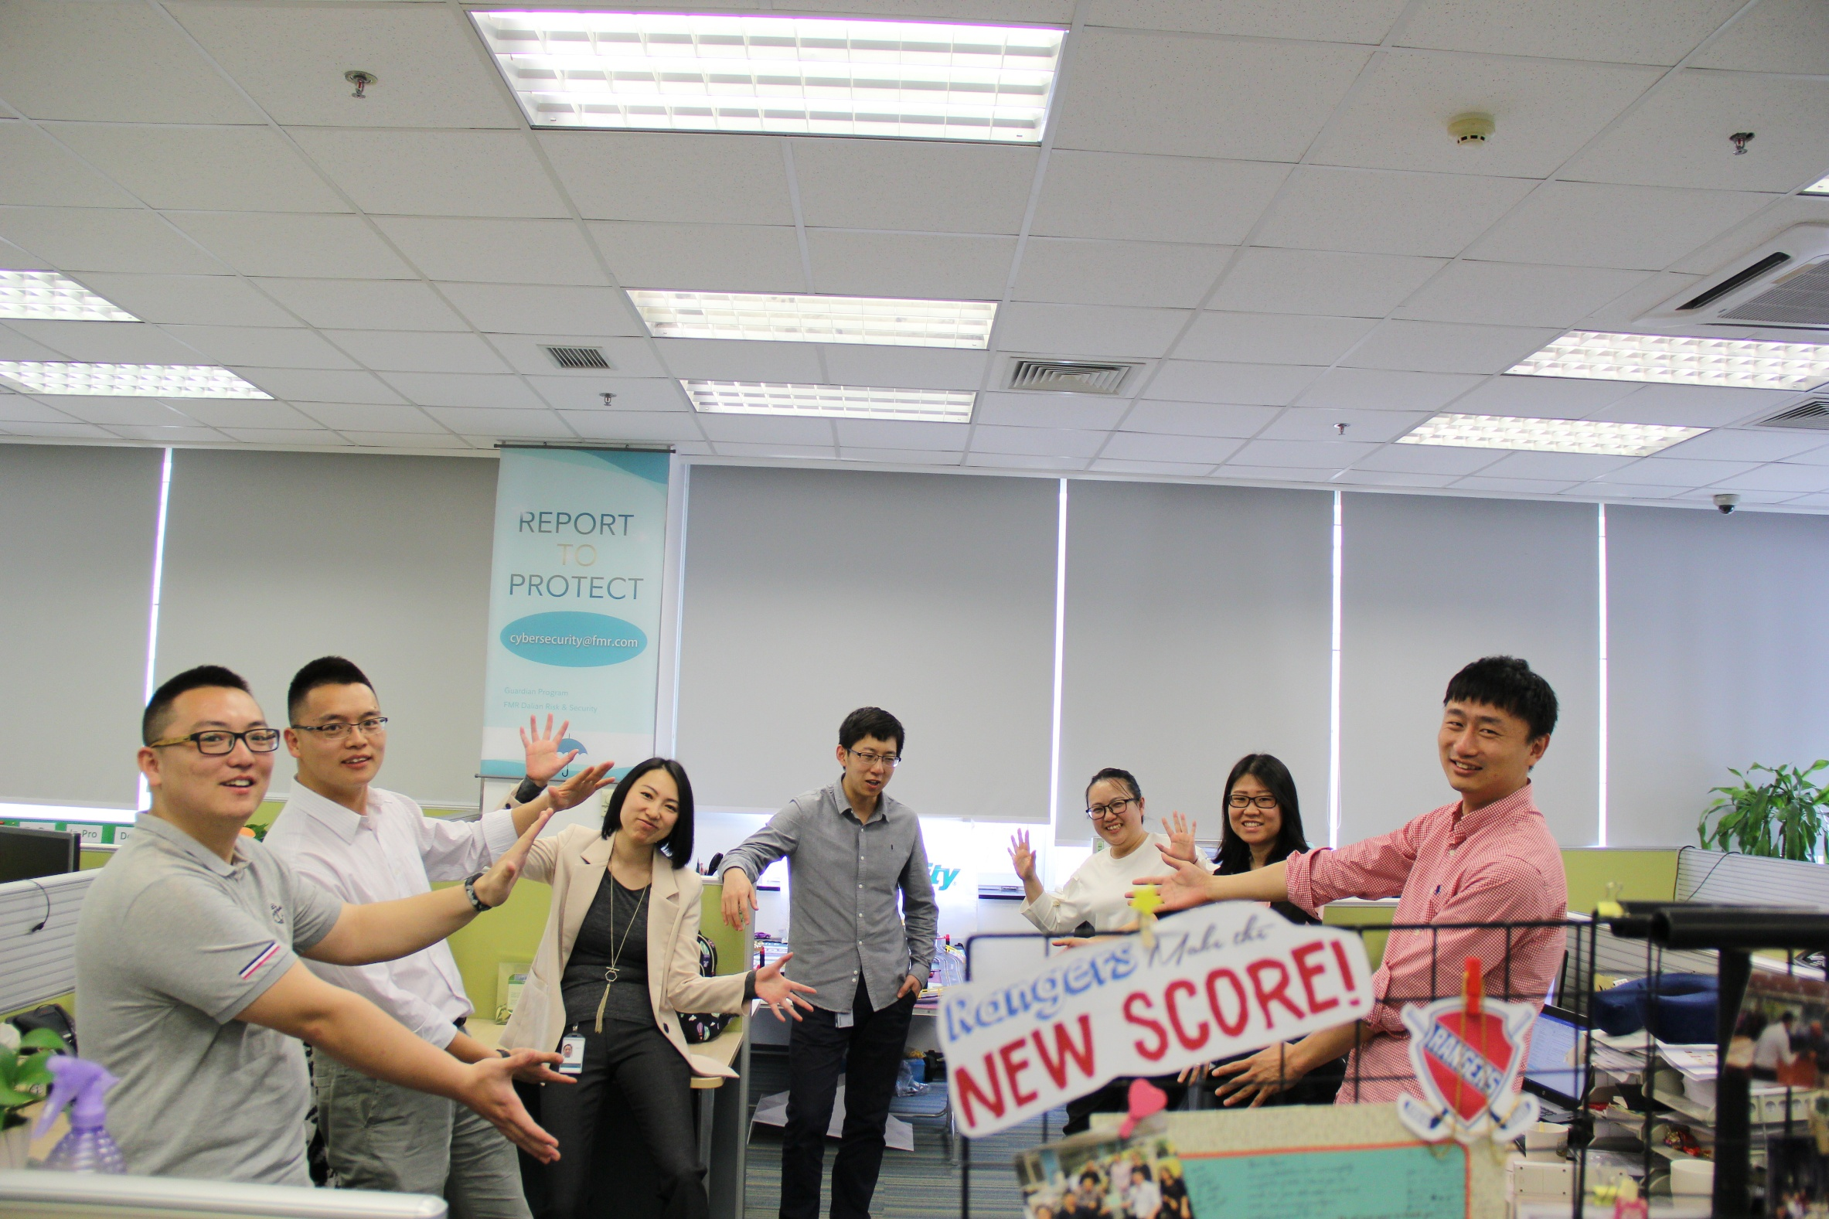
Next Generation Scoring
New Generation Scoring was released on Oct 15th 2018.
The New Generation Scoring considers more situation and calculates more realistic score for customer.

Slide 18
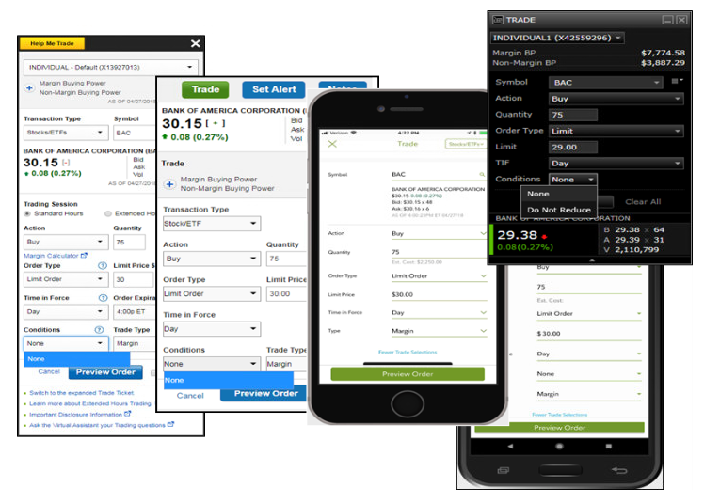

AON
Eliminated 30,000 phone calls and saving around
1 Million dollars per year.
Leverage data driven approach to deliver quick hit items that provides fantastic customer experience and business value.

Slide 19
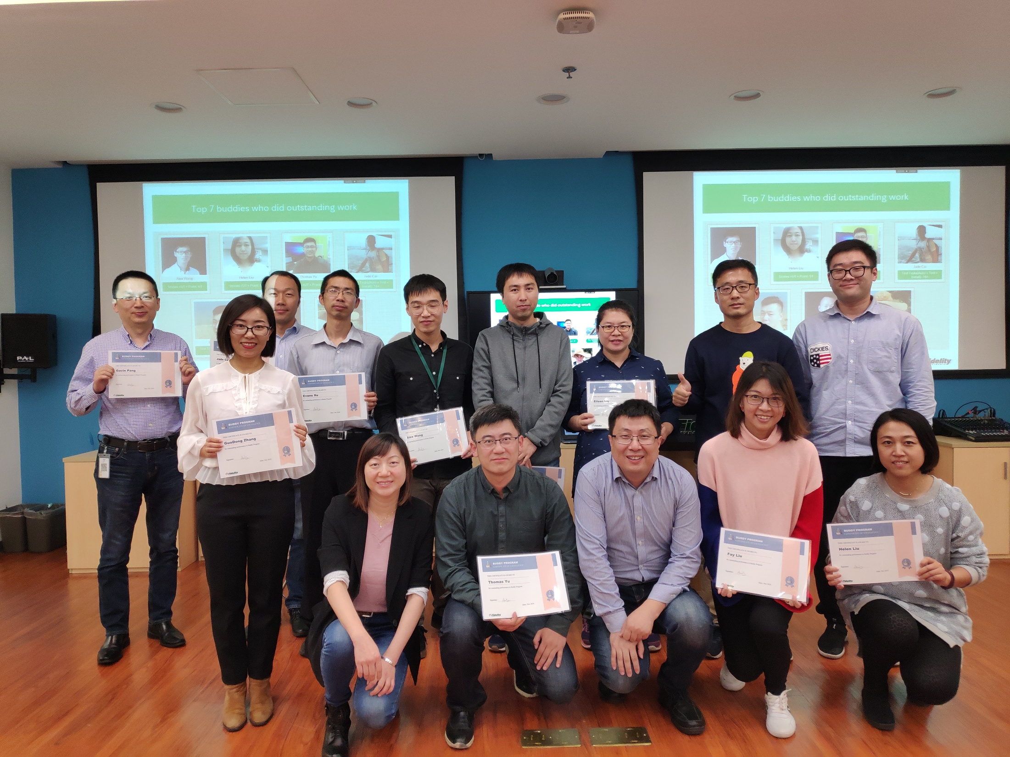

Buddy Program
33 pairs of buddies joined in the program as pilot.
It bundled Developer and QA to work and learn together.

Slide 20
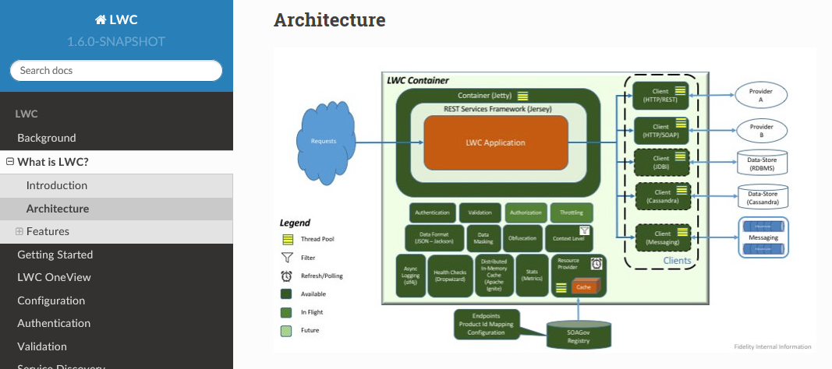
LWC
As of November 2018, 66.7% trading traffic started using LWC which greatly increase the stability of our trading services.

Slide 21
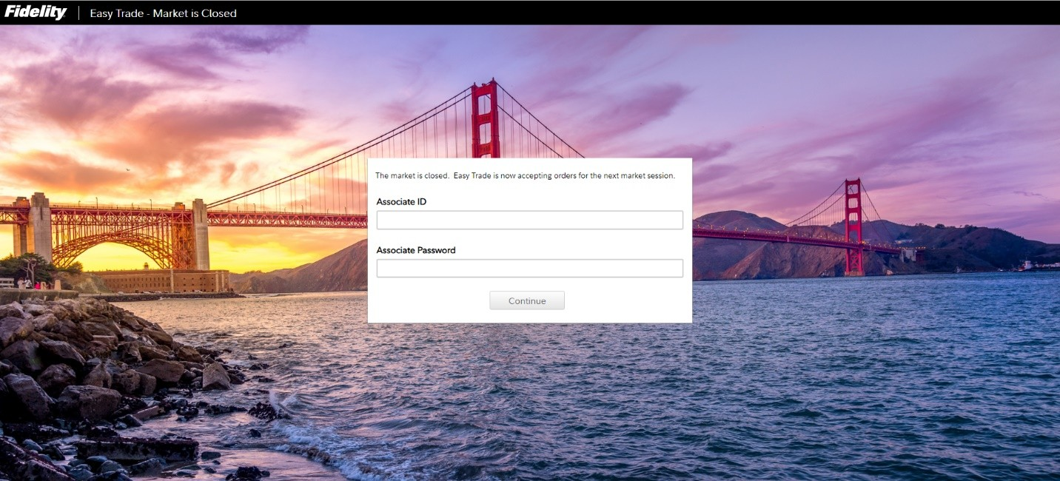
Easy Trade
Released on Nov 27th 2018.
Easy Trade helps us maintain our market leading position in the tool space.

Slide 22
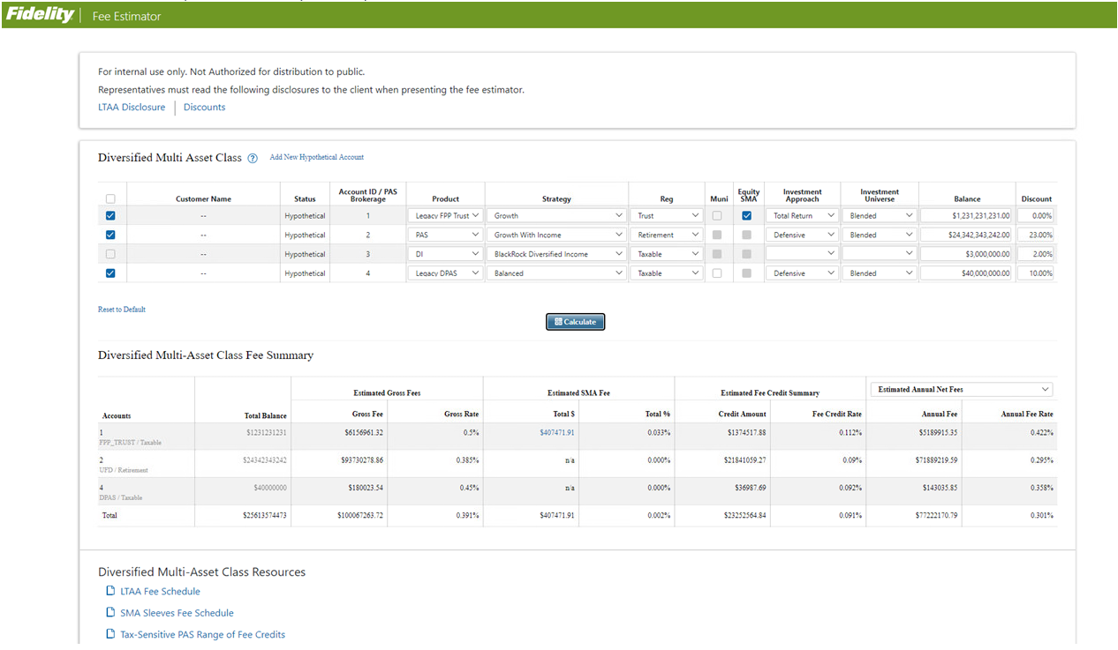
Fee Estimator
Released in November 2018.
The new Fee Estimator helps our reps by giving them a more straightforward view of client fees.

Slide 23
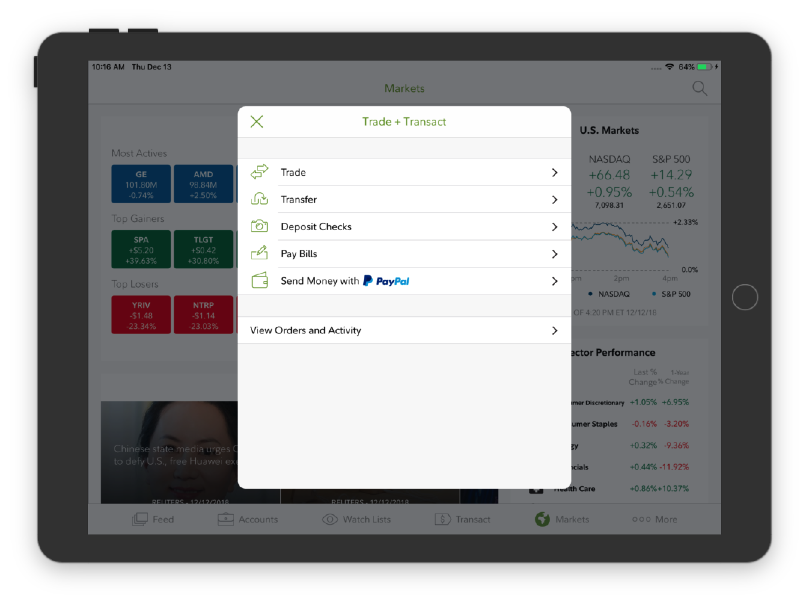

P2P Payment
P2P payment makes the trade and transaction more easier in near real-time.
P2P payment went live on both Fidelity web and mobile APPs in November.

Slide 24

Financial Solutions
and
Planning & Advice Platform
13.2 Million – the number of Goals that our customers are counting on Fidelity to help them achieve in 2018.

